Slide 1
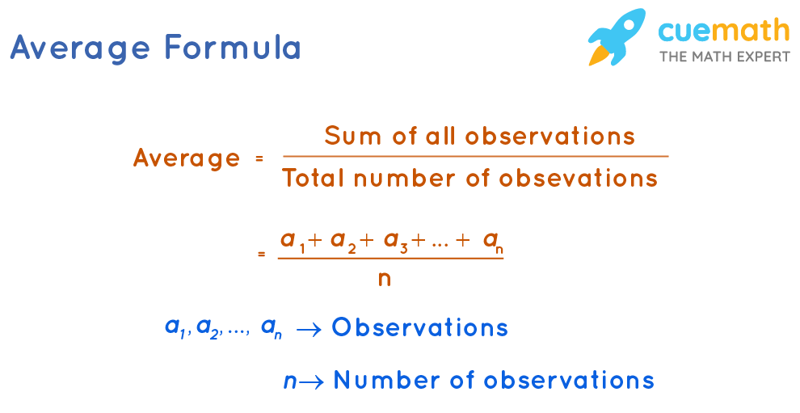
Average
Ilknur, Aytaj, Zeynab, Leyla

Slide 2
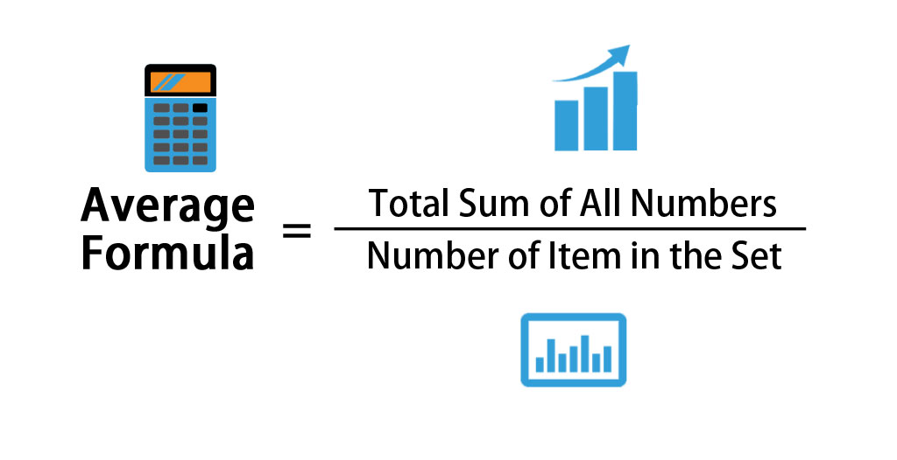
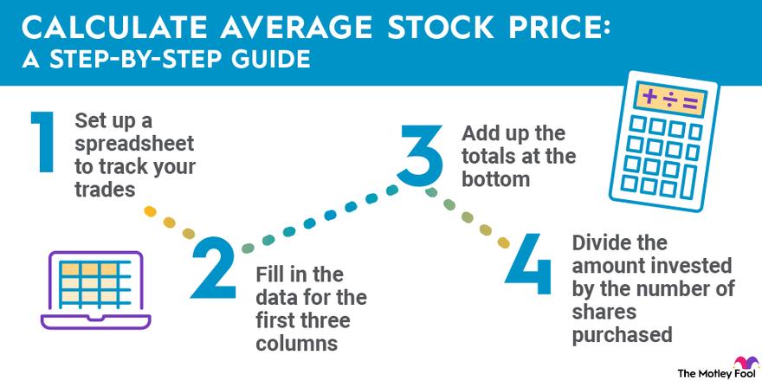
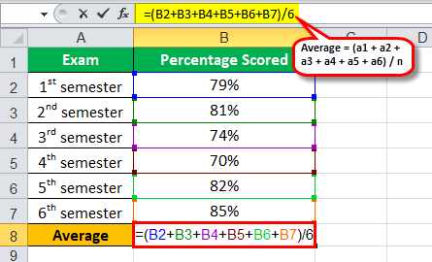
What is Average?
THE mean value of a collection of data is usually referred to as the "average" in computer and technology contexts. In order to compute it, all of the values are added together and then divided by the total number of values.
USE in excel file

Slide 3

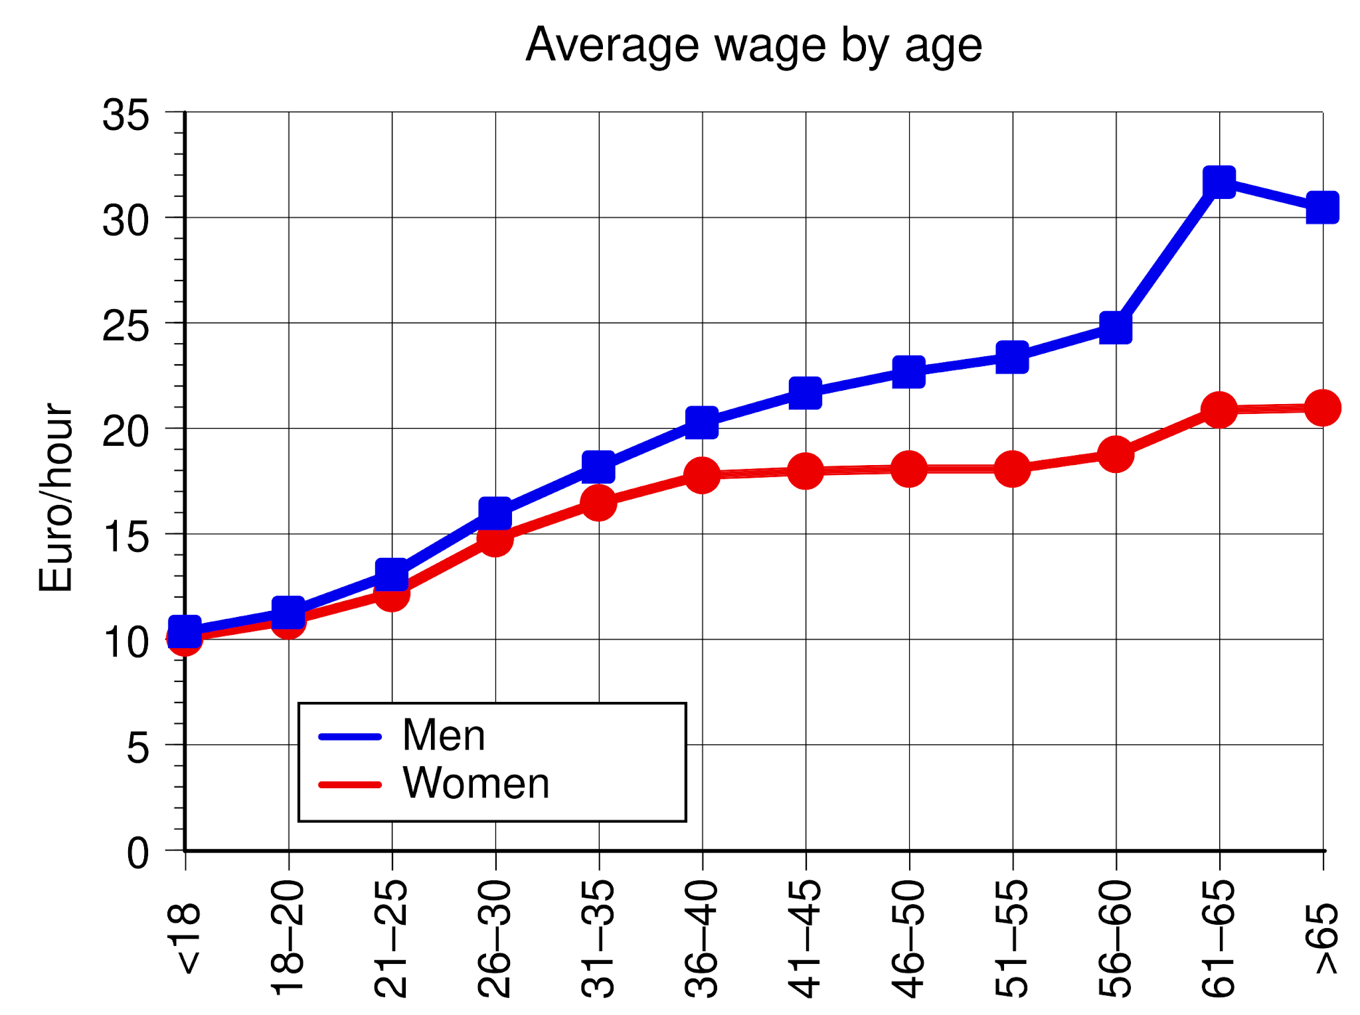
Real Life problem and application.
The researchers conducted a survey over some group of people and want to determine the average of age groups using Instagram. Write a code to calculate the average value, if the amount of users aged 18, 25, 45, 70 are 20, 90, 49,23 respectively.

Slide 4
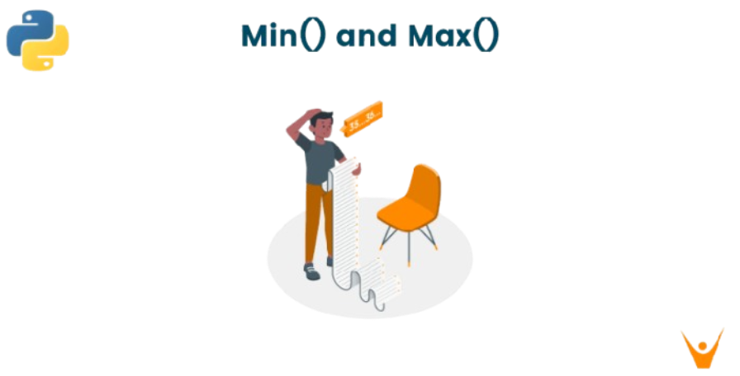
Minimum and Maximum
Ilknur, Aytaj, Zeynab, Leyla

Slide 5
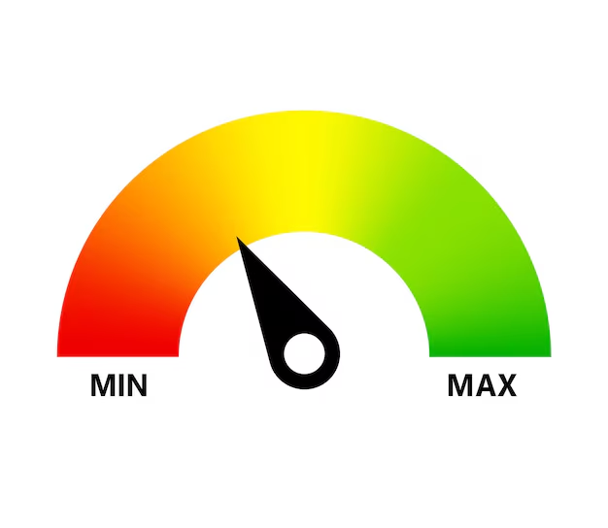
What is Minimum and Maximum?
Minimum is the lowest value in a set of data
Maximum is the highest value in a set of data
{ 1;4;7;9;20;45 }

Slide 6
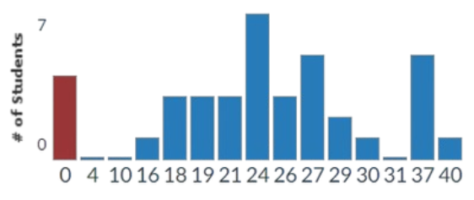
Real Life problem and application.
This graph illustrates the gardes of the students in 10A class. Eve
MAXIMUM = 40
MINIMUM = 0

Slide 7
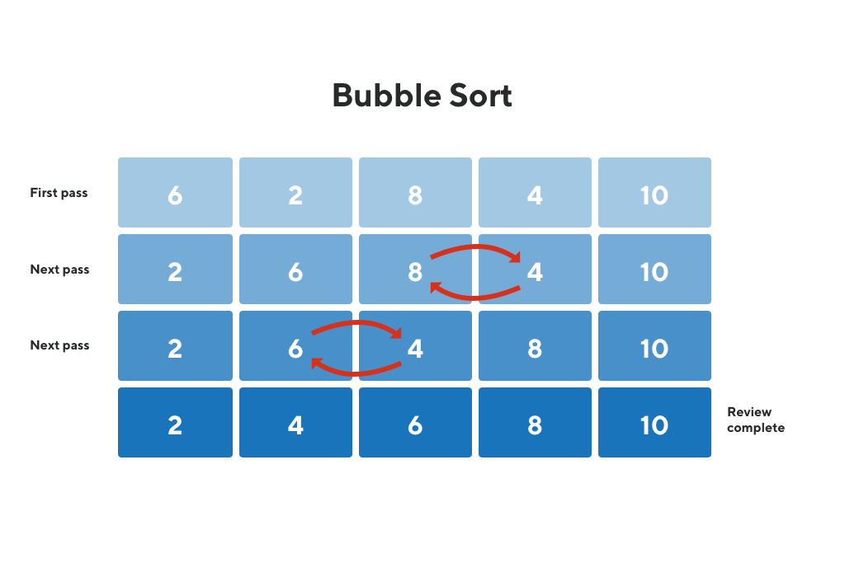
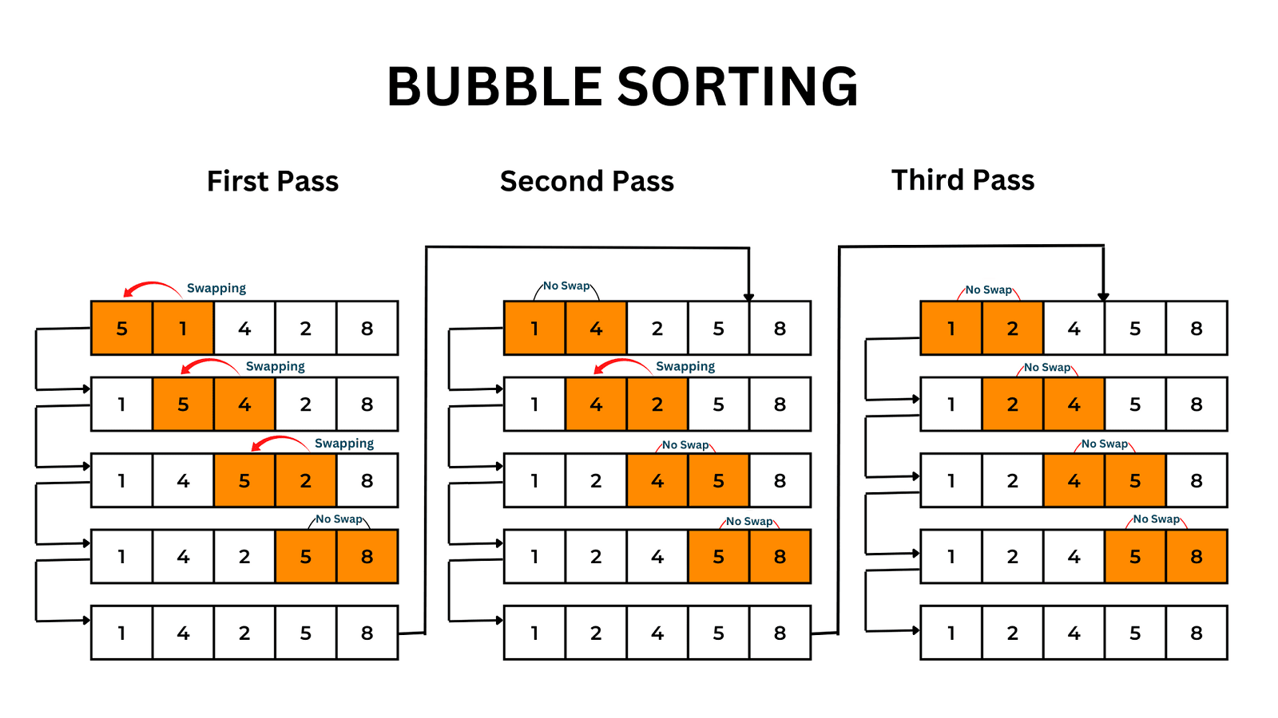
Bubble sort
One of the most basic sorting algorithms is bubble sort. Constantly going over the list, comparing neighboring entries, and switching if they are out of order is how it operates. It is only utilized for instructional reasons and is not realistically employed due to its subpar performance.

Slide 8
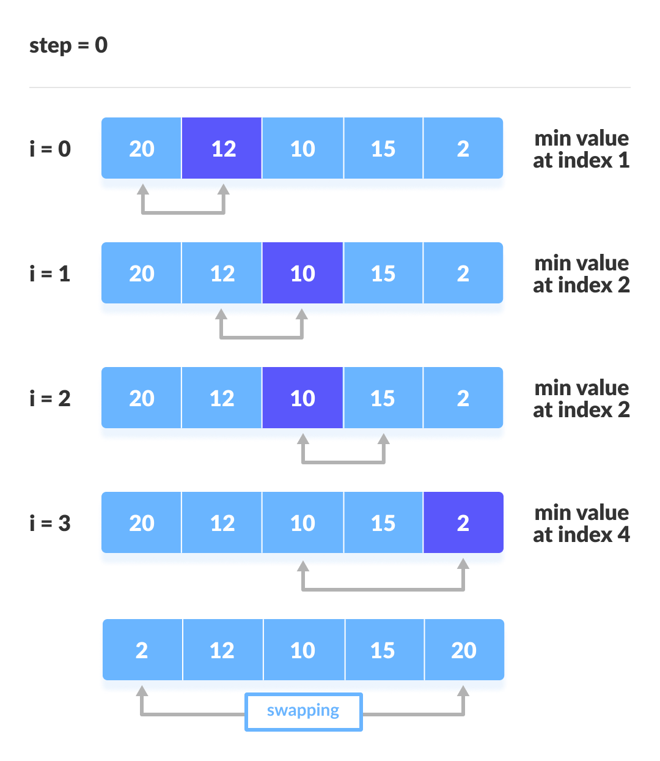
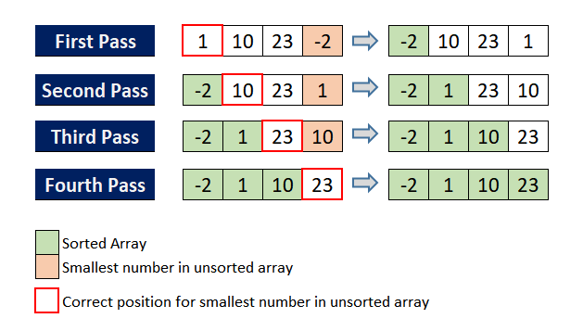
Selection sort
Selection sort is a sorting algorithm that, in each iteration, chooses the smallest element from an unsorted list and positions it at the start of the list.

Slide 9
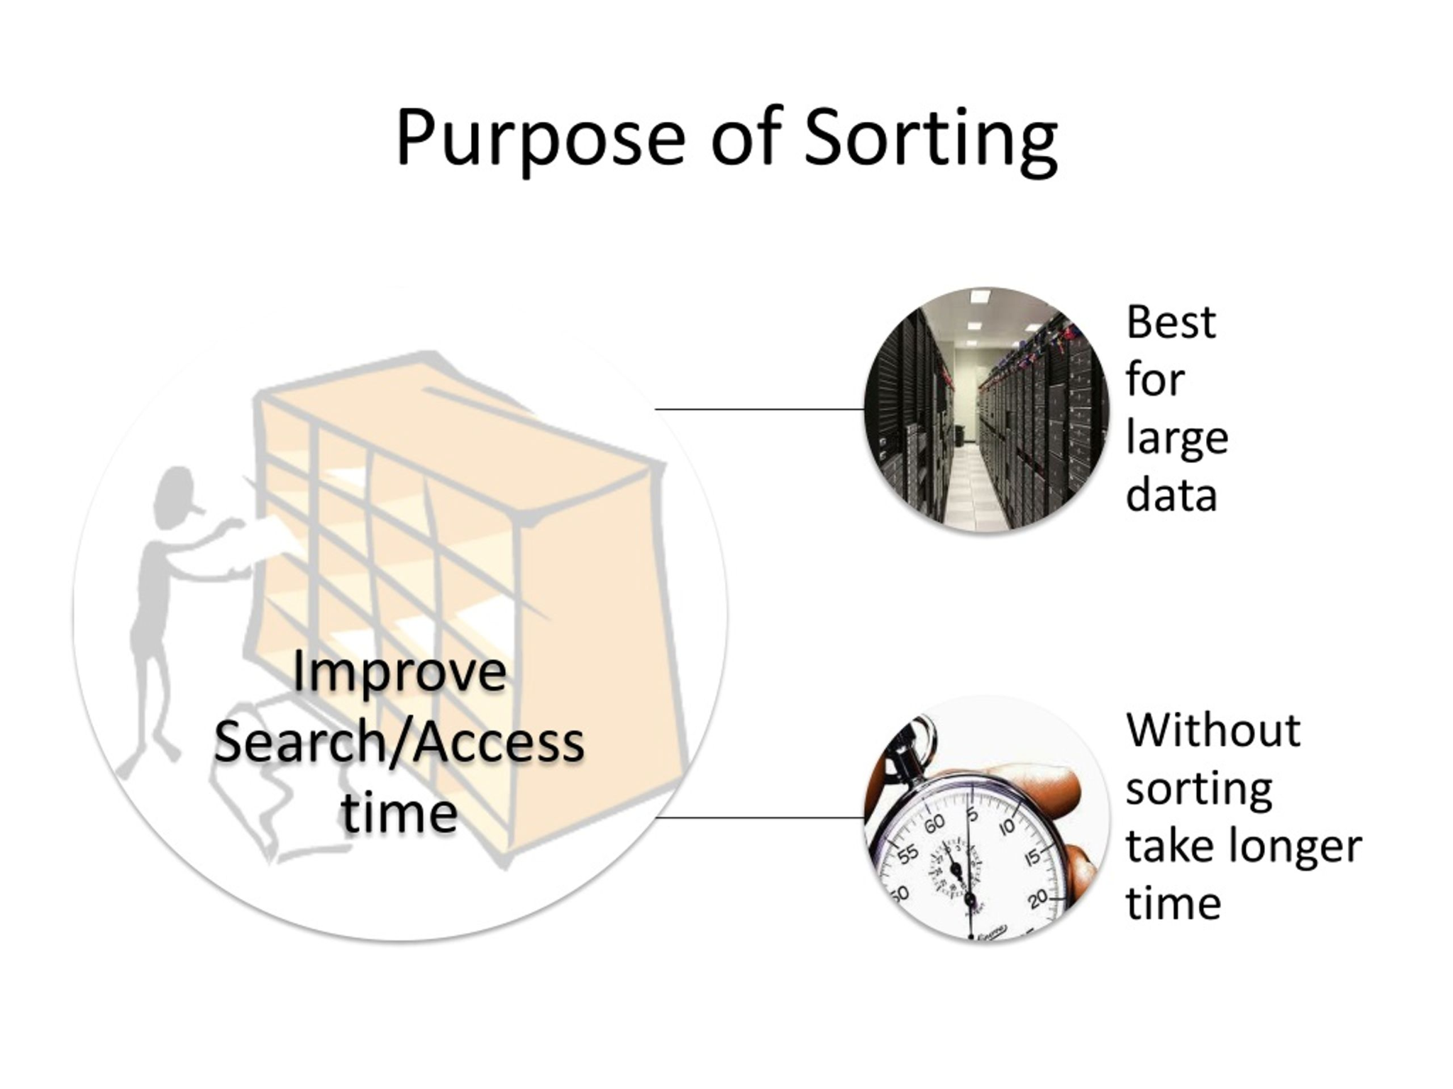
Purpose of sorting
In programming: Sorting facilitates data organization for easy display, analysis, and search. Efficiency is increased, particularly while finding and processing big databases.
In Actual Life: Sorting puts information in a logical order (e.g., alphabetical, by size, price, or time) and helps us find things more quickly and make better judgments.

Slide 10
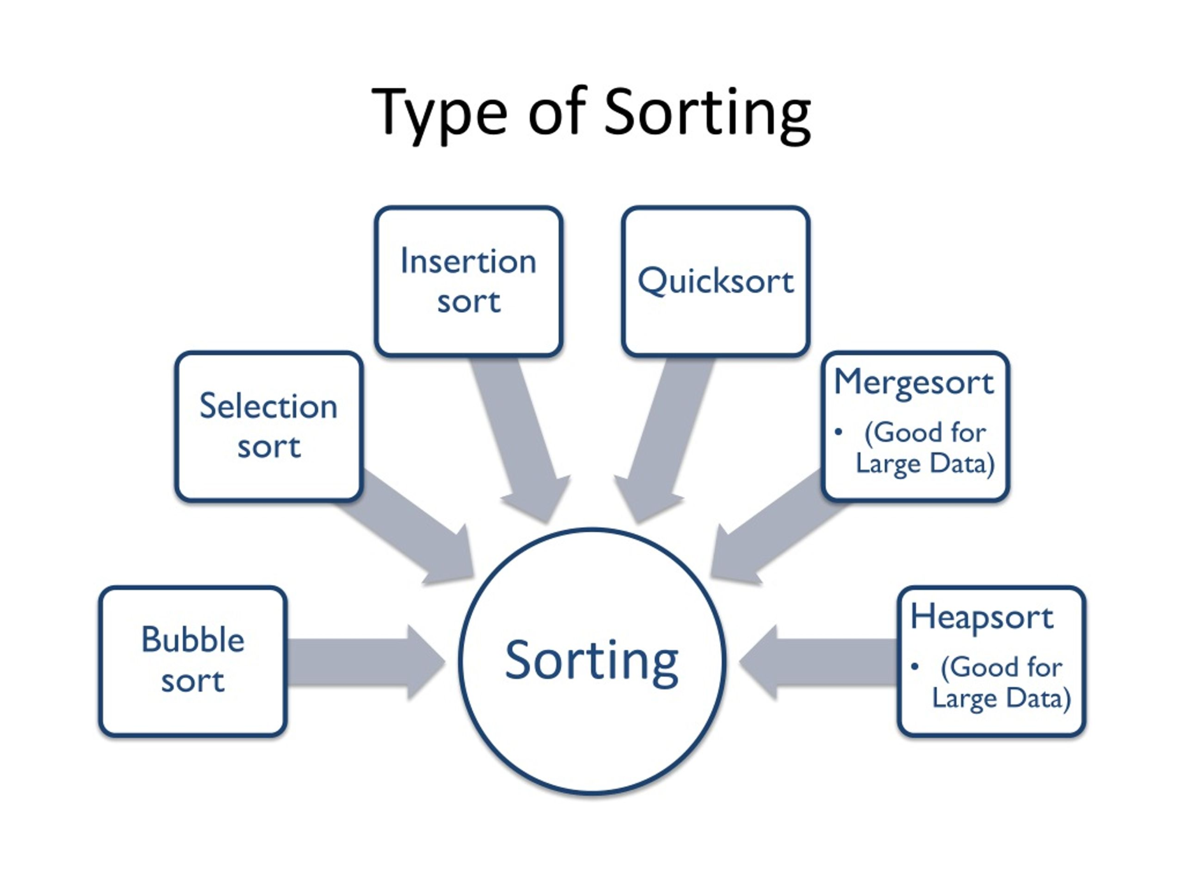
Real life examples
Online shopping - The following filters are used by online retailers to assist users select the best or most economical products: price (low to high)
Scheduling Tasks - Important tasks are completed first and nothing is overlooked by sorting tasks by due date or priority in time management applications or calendars.

Slide 11
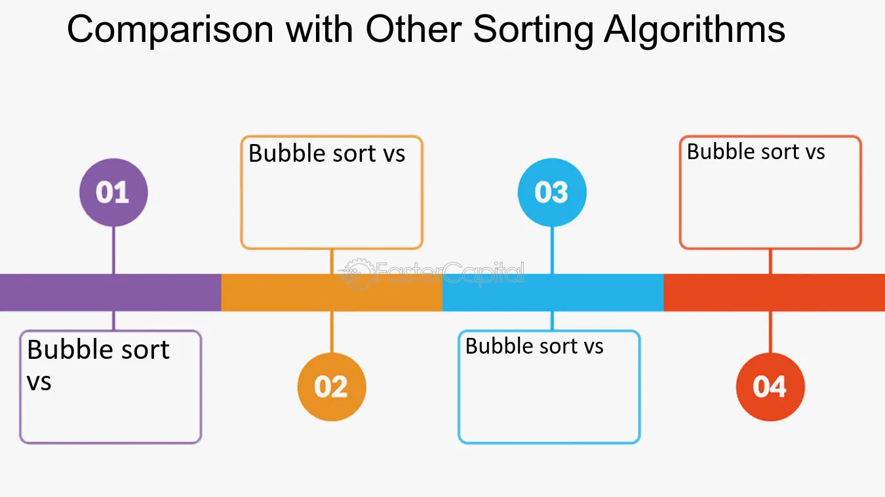
Why is Bubble Sort not commonly used in large software systems?
Weaknesses of Bubble Sort
Slow Performance
Much slower than Merge Sort, Quick Sort, or Heap Sort with O(n log n) time.
Inefficient for Large Data
Performance degrades quickly as data size grows.
Poor Memory Usage
Doesn’t leverage CPU caching or memory locality effectively.
Better Alternatives
Merge Sort – stable, predictable performance.
Quick Sort – fast in practice for most datasets.
Timsort – used in Python, optimized for real-world data.
When Is It Used?
Learning tool – great for teaching sorting basics.
Small datasets – acceptable when performance isn't critical.

Slide 12
Which sorting method is used in Java's built-in sorting method Arrays.sort?
Java's built-in Arrays.sort uses different sorting algorithms depending on the data type:
For primitives it uses Dual-Pivot Quicksort because it's fast and efficient for primitive data.
For objects it uses Mergesort, a mix of Merge Sort and Insertion Sort. Timsort is stable and works well on real-world data that often contains ordered sequences.
Why?
Quicksort is fast for primitive types and doesn’t need stability.
Timsort is used for objects because it's stable and efficient on partially sorted data.

